Slide 1

AI-Based NutriSmart System for Personalized Nutrition, Recipe Recommendation, and Budget Meal Planning
CSA4305-Internet Programming
Presented by: T Gnaneswari
P Madhavi
M Ramya sri
V Dharani
P V Prakalya
Faculty:
Dr D Sudhagaran Saveetha School Of Engineering

Slide 2


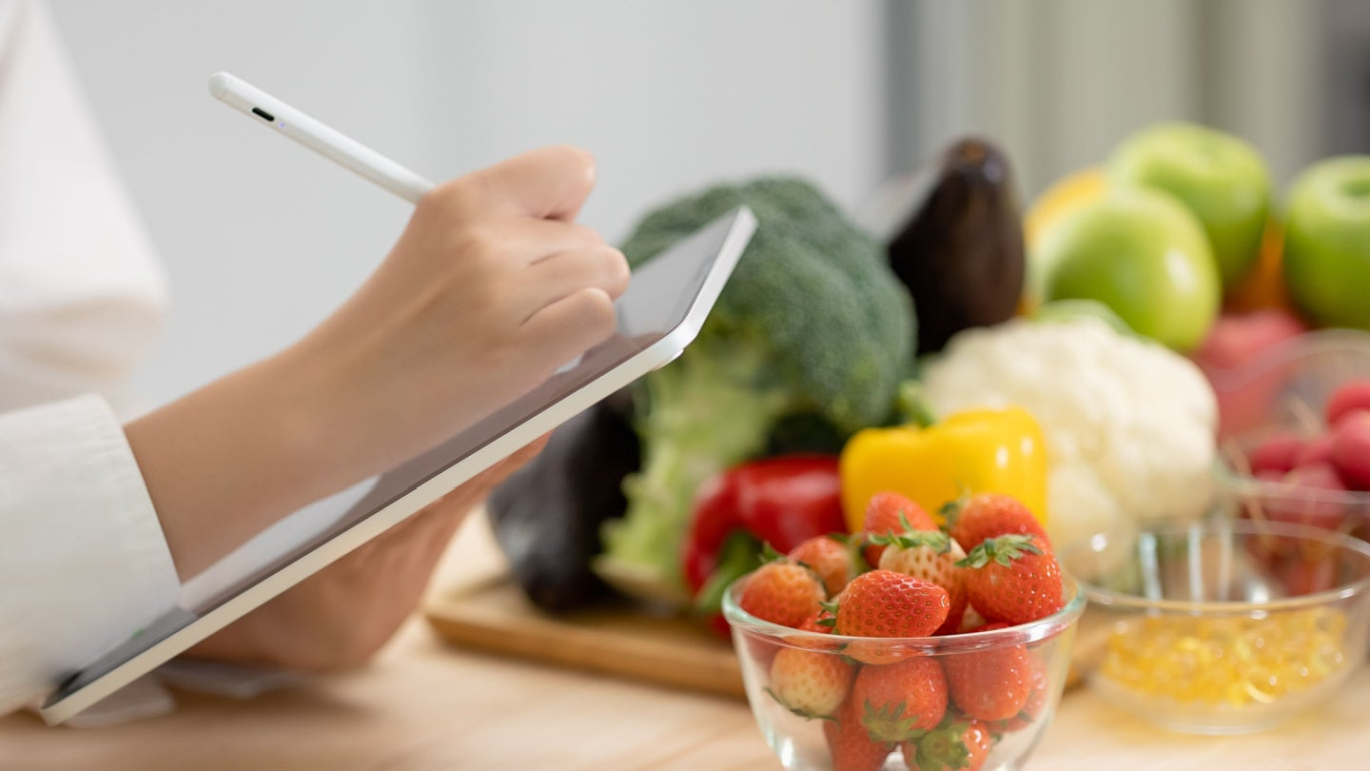
ABSTRACT
The AI-Based NutriSmart System is a personalized nutrition and meal-planning application designed to help users maintain healthy eating habits.
The system collects user details such as age, gender, height, weight, activity level, health condition, dietary preference, fitness goal, allergies, and food budget.
Using artificial intelligence, the system generates personalized daily and weekly meal plans based on the user’s nutritional requirements.
It also recommends recipes using the ingredients available to the user and provides estimated calories, nutrients, cooking time, and meal cost.
The system includes budget-based meal planning, health and nutrition analytics, meal reminders, progress monitoring, and feedback collection.
The main objective of the system is to make healthy eating personalized, affordable, simple, and accessible.

Slide 3
INTRODUCTION
Maintaining a healthy diet is important for preventing diseases, improving physical fitness, and supporting overall well-being. However, many people find it difficult to select suitable meals according to their health conditions, dietary preferences, nutritional requirements, and available budget.
Traditional meal-planning methods usually provide general diet plans that may not consider individual needs.
Users may also face difficulties in calculating calorie requirements, identifying healthy recipes, controlling food expenses, and following meal schedules regularly.
The AI-Based NutriSmart System solves these problems by providing personalized nutrition recommendations.
The system analyzes user health information and generates suitable meal plans, recipes, nutrition details, grocery lists, and budget summaries.

Slide 4
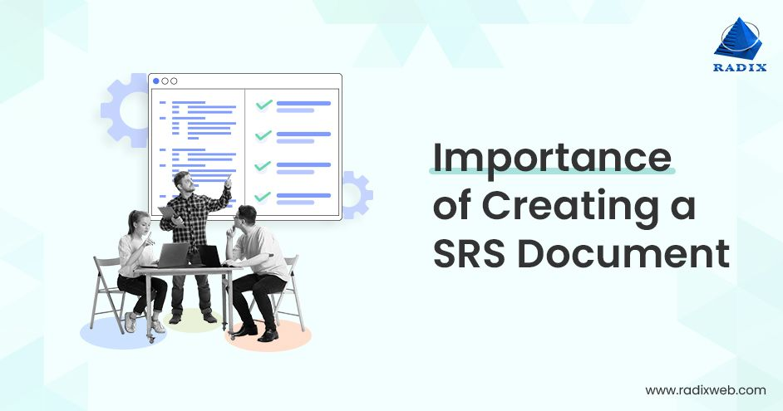
PROBLEM STATEMENT
Many people struggle to follow a healthy diet because they do not have proper knowledge about calories, nutrients, balanced meals, food costs, and suitable recipes.
Existing meal-planning applications often provide common diet plans without considering important factors such as:
Age
Gender
Height and weight
Fitness goals
Activity level
Medical conditions
Users also face difficulty in planning affordable meals, tracking calorie intake, remembering meal timings, and monitoring their health progress.
Food allergies
Dietary preferences
Available ingredients
Daily or weekly budget

Slide 5



SDG GOALS
SDG Goal | Contribution of NutriSmart
SDG 2 – Zero Hunger | Supports affordable and nutritious meal planning through AI-based budget recommendations.
SDG 3 – Good Health and Well-Being | Provides personalized meal recommendations based on health data, nutritional needs, dietary preferences, and fitness goals.
SDG 12 – Responsible Consumption and Production | Recommends recipes using available ingredients, helping users make better use of food and potentially reduce food waste.

Slide 6
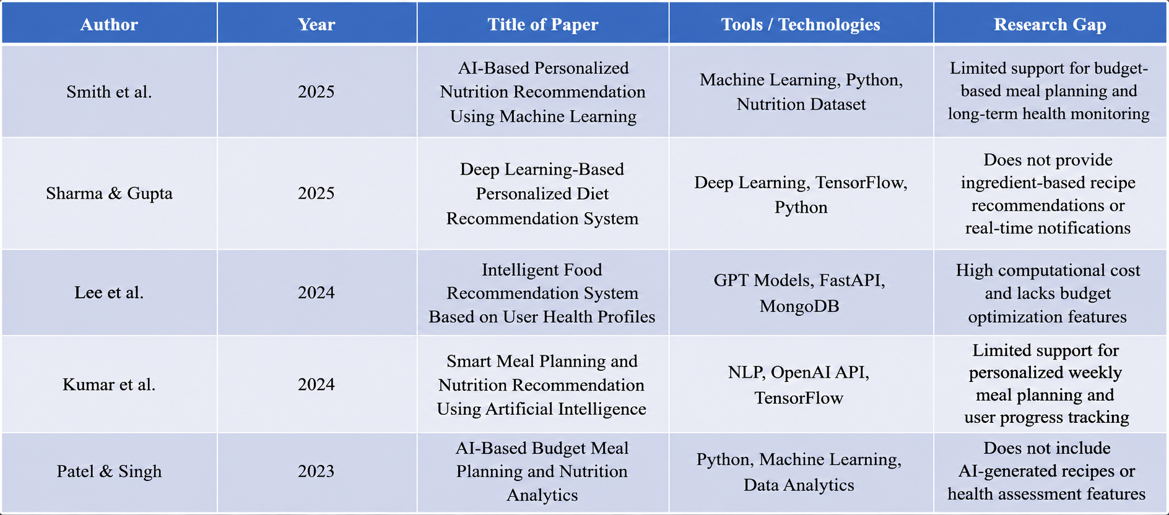
LITERATURE REVIEW

Slide 7
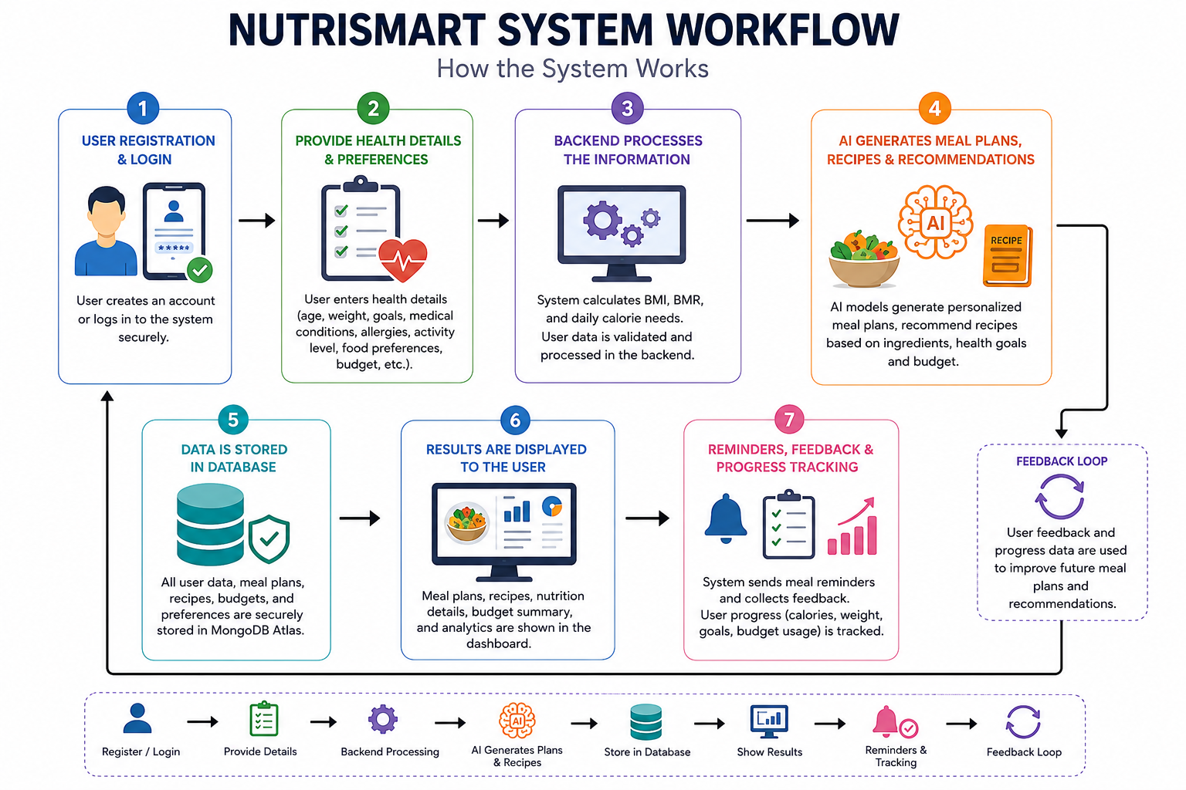
SYSTEM ARCHITECTURE

Slide 8
Module 1 – User Profile and Health Assessment
Objective
To collect and analyze users' personal, health, and dietary information in order to generate personalized nutrition recommendations and healthy meal plans.
Functionality
Registers and authenticates users securely.
Collects user profile details such as age, gender, height, weight, and target weight.
Records dietary preferences, allergies, medical conditions, and fitness goals.
Calculates BMI, BMR, and daily calorie requirements.
Stores user information securely in MongoDB Atlas.
Provides personalized health assessment for AI-based meal planning.

Slide 9
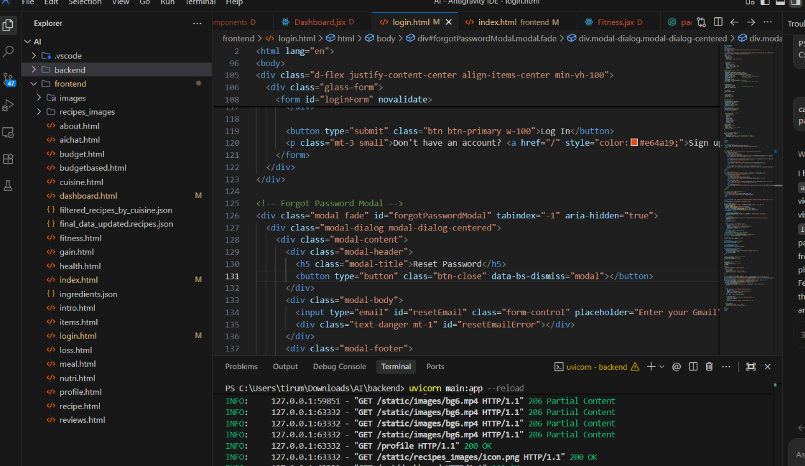
Modules Implementation

Slide 10
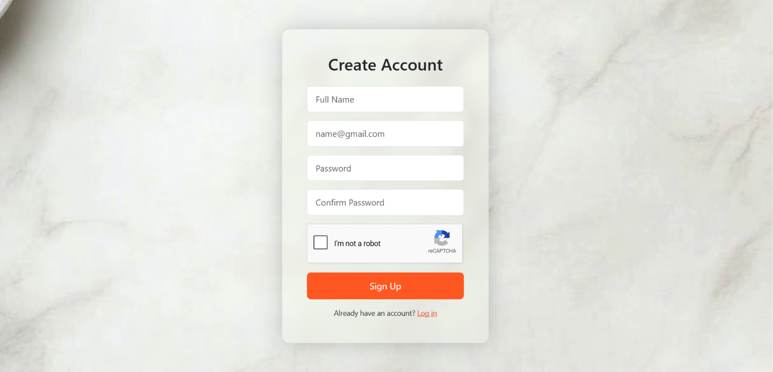
Module 2 Outcome

Slide 11
Module 2 – AI-Based Personalized Meal Planning
Objective
To generate personalized daily and weekly meal plans based on the user's nutritional requirements, health conditions, and fitness goals using Artificial Intelligence.
Functionality
Generates AI-powered personalized meal plans.
Creates breakfast, lunch, snacks, and dinner schedules.
Calculates calories, protein, carbohydrates, fats, and fibre for each meal.
Supports weight loss, weight gain, diabetic, vegetarian, vegan, and keto meal plans.
Regenerates meals based on user preferences.
Tracks daily and weekly nutritional intake.

Slide 12
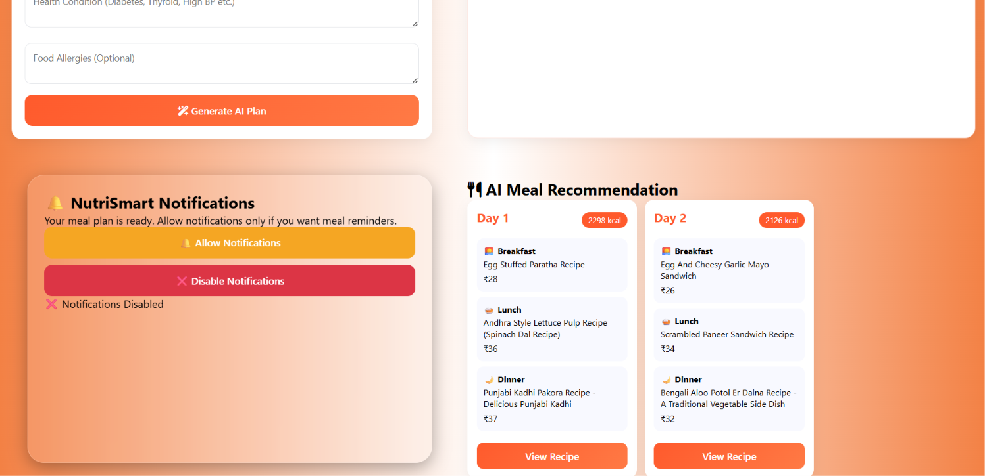
Module 2 Outcome

Slide 13
Module 3 – AI Recipe Recommendation
Objective
To recommend suitable recipes based on available ingredients and generate customized recipes using Artificial Intelligence.
Functionality
Accepts ingredients entered by the user.
Recommends recipes using ingredient matching.
Generates AI-based recipes with cooking instructions.
Displays recipe images using the Pexels API.
Shows nutritional information and estimated meal cost.
Allows users to save favourite recipes and provide ratings and feedback.

Slide 14
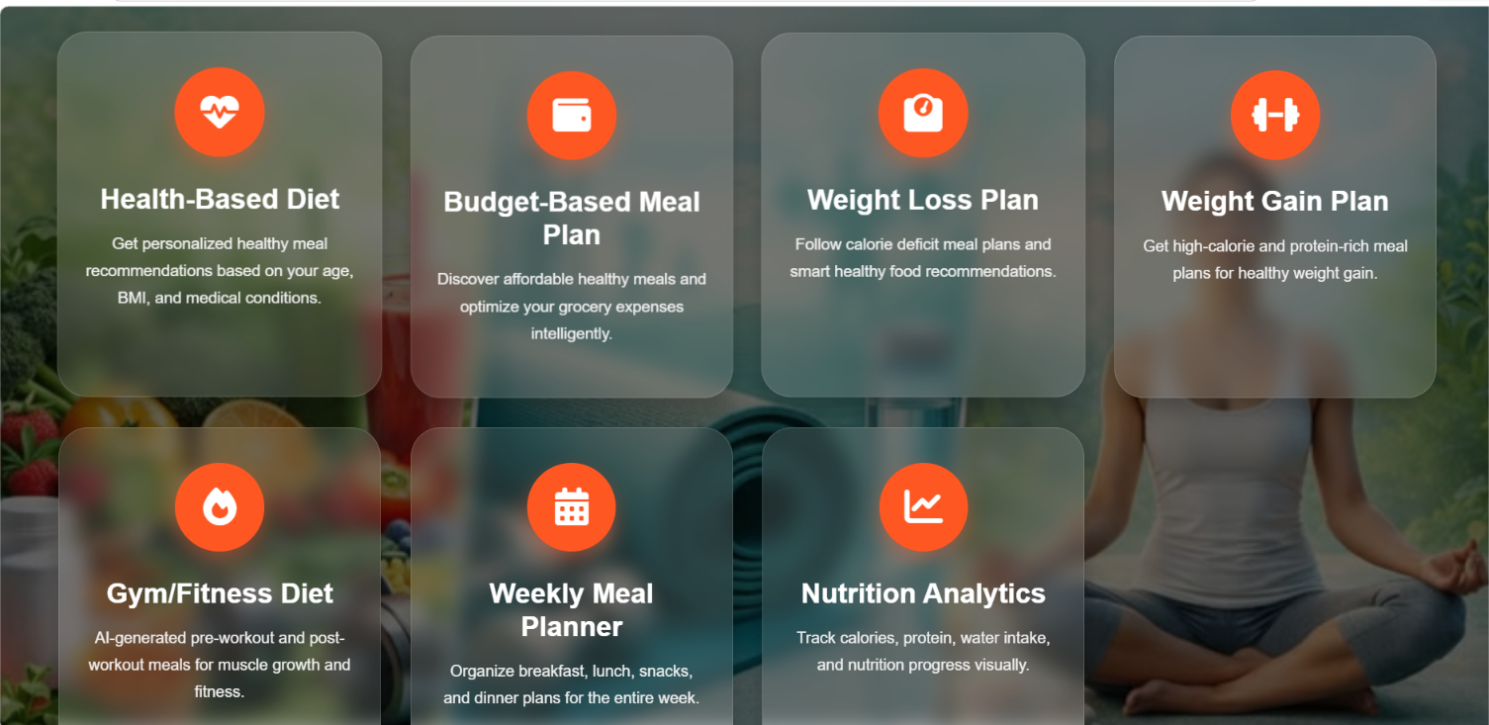
Module 3 Outcome

Slide 15
Module 4 – Smart Budget and Nutrition Analytics
Objective
To provide healthy and affordable meal plans while helping users manage their food budget and monitor nutritional intake.
Functionality
Generates budget-friendly meal plans.
Calculates meal costs and remaining budget.
Creates grocery lists for selected meal plans.
Displays calorie and nutrition analytics.
Provides budget utilization reports using interactive charts.
Monitors daily and weekly nutrition progress through dashboards.

Slide 16
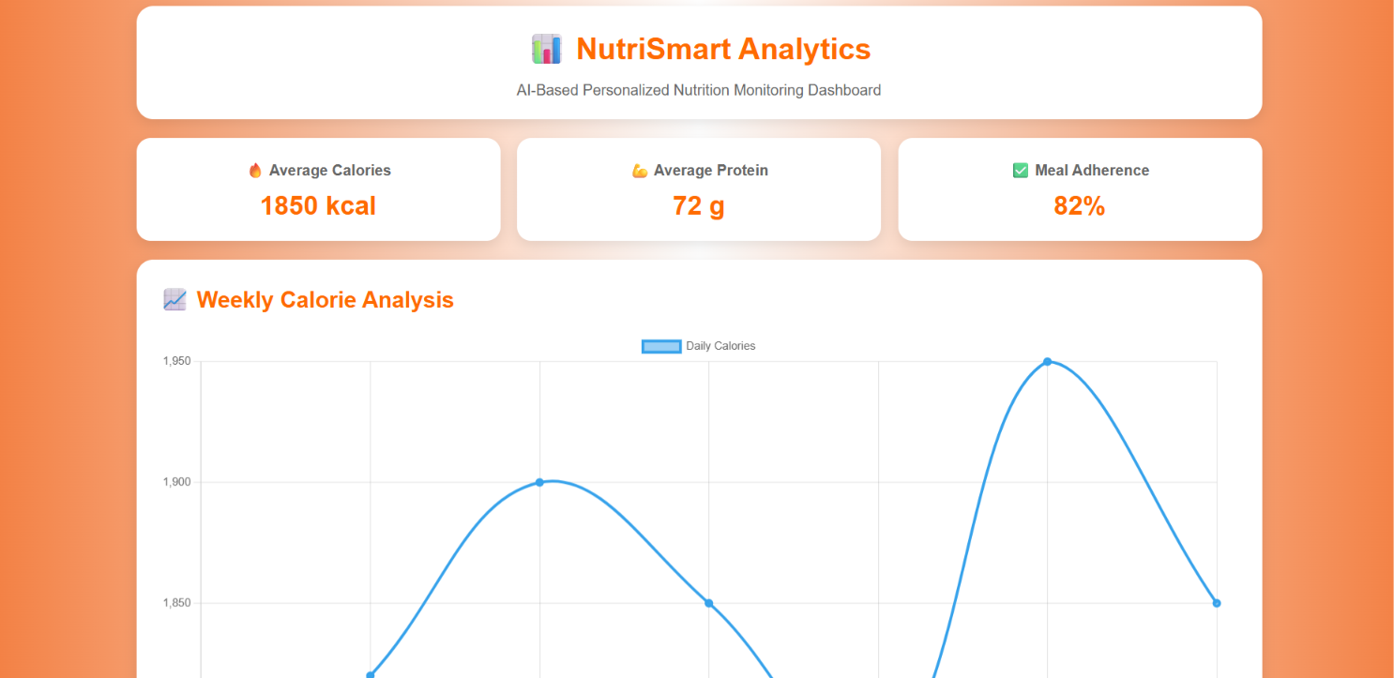
Module 4 Outcome

Slide 17
Module 5 – Notifications and Progress Monitoring
Objective
To improve user consistency in following healthy eating habits through reminders, progress tracking, and personalized health monitoring.
Functionality
Sends reminders for meals, water intake, and exercise.
Collects meal completion and feedback from users.
Tracks calorie intake, weight changes, and meal completion percentage.
Generates daily, weekly, and monthly progress reports.
Displays health and nutrition progress using charts and dashboards.
Encourages healthy lifestyle habits through continuous monitoring and notifications.

Slide 18
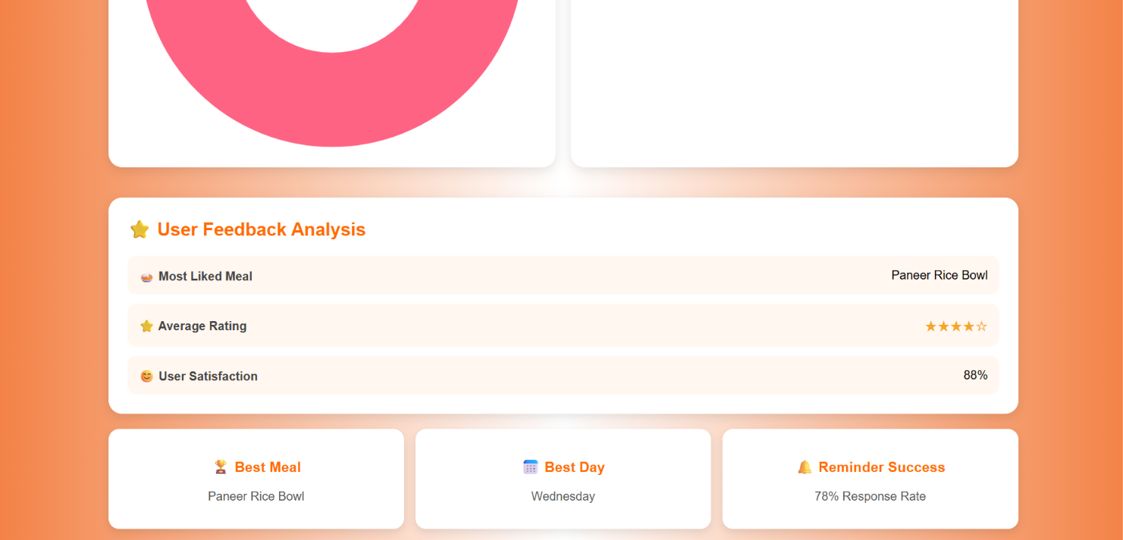
Module 5 Outcome

Slide 19
FUTURE SCOPE
Develop native Android and iOS mobile applications.Integrate wearable devices such as smartwatches and fitness bands.
Implement food image recognition using Computer Vision and Deep Learning.Add barcode and QR code scanning for packaged food nutrition analysis.
Support multiple regional and international languages.Provide voice-enabled AI nutrition assistant and chatbot.
Enable online grocery ordering based on generated shopping lists.Introduce disease-specific diet plans for diabetes, hypertension, thyroid, PCOS, and heart diseases.Integrate with electronic health records (EHR) for personalized healthcare recommendations.
Predict future health risks using Machine Learning algorithms.Recommend seasonal and locally available food items.Provide real-time calorie tracking through fitness applications.
Add nutrition consultation with certified dietitians.Reduce food waste by suggesting recipes using leftover ingredients.

Slide 20
CONCLUSION
The AI-Based NutriSmart System for Personalized Nutrition, Recipe Recommendation, and Budget Meal Planning successfully demonstrates how Artificial Intelligence can be applied to improve healthy eating habits and personalized nutrition management. The system analyzes user information such as age, gender, height, weight, activity level, fitness goals, dietary preferences, allergies, medical conditions, and food budget to generate customized meal plans and recipe recommendations.The inclusion of reminder notifications and health tracking encourages users to maintain consistency in following their meal plans and achieving their health goals. Built using modern technologies such as HTML5, CSS3, JavaScript, Bootstrap, Python, FastAPI, MongoDB Atlas, OpenAI API, Pexels API, and Browser Notification API, the system offers a scalable, secure, and user-friendly platform. Overall, the NutriSmart System effectively combines artificial intelligence, web technologies, and data analytics to provide an intelligent solution for personalized nutrition, making healthy eating simpler, smarter, and more accessible for users.
.

Slide 21
REFERENCES
Smith, J. Brown, and L. Wilson, “AI-Based Personalized Nutrition Recommendation Using Machine Learning,” International Journal of Intelligent Systems and Applications, vol. 17, no. 2, pp. 45–58, 2025.
R. Sharma and P. Gupta, “Deep Learning-Based Personalized Diet Recommendation System,” IEEE Access, vol. 13, pp. 67890–67905, 2025.
S. Kumar, A. Verma, and R. Singh, “Smart Meal Planning and Nutrition Recommendation Using Artificial Intelligence,” Journal of Systems and Software, vol. 208, pp. 145–158, 2024.
M. Lee, J. Park, and S. Kim, “Intelligent Food Recommendation System Based on User Health Profiles,” IEEE Transactions on Artificial Intelligence, vol. 5, no. 4, pp. 876–889, 2024.
K. Patel and D. Singh, “AI-Based Budget Meal Planning and Nutrition Analytics,” International Journal of Advanced Computer Science and Applications, vol. 16, no. 3, pp. 210–221, 2024.
T. Johnson and M. Davis, “Personalized Health Monitoring and Meal Recommendation Using Artificial Intelligence,” Journal of Medical Systems, vol. 48, no. 7, pp. 95–108, 2024.

Slide 22


